Slide 1
Peak Detection in Time Series
Presentation of Final Results
Nestor Weidemann, Nathira Wijemanne
Autonomous Multisensor Systems Group
Institute for Intelligent Cooperating Systems
Faculty of Computer Science
Otto von Guericke University Magdeburg
16.09.2025

Slide 2
Overview
Slide number “3/…” instead of just “3”
Adapt names in footer depending on who is presenting
Add sources for all “external” graphics
Peak Detection in Time Series | N. Weidemann, N. Wijemanne

Slide 3
1.
Introduction
2.
Experimental Setup
3.
Results
4.
5.
Evaluation
Conclusion
Peak Detection in Time Series | N. Weidemann, N. Wijemanne

Slide 4
1. Introduction
2.
3.
4.
5.
Sustainability
From general/high-level to more specific
Less text
Explain what a cnc machine is
Peak Detection in Time Series | N. Weidemann, N. Wijemanne

Slide 5
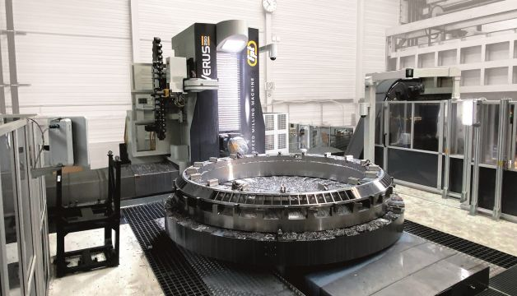
1. Introduction
2.
3.
4.
5.
Motivation
Sudden power surges can occur in the motor current of a milling machine
Important to distinguish between normal power increases and abnormal peak anomalies
Consequences
Stress on the drive electronics, leading to a reduced motor lifespan
Increase in energy consumption
Peak Detection in Time Series | N. Weidemann, N. Wijemanne
Notes:
normal power increases are caused by the tool engaging with material

Slide 6
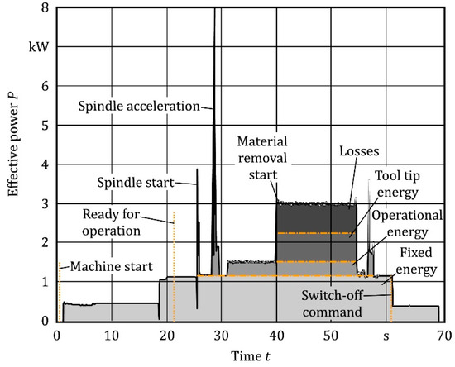
1. Introduction
2.
3.
4.
5.
Task
Implement and compare different approaches for peak detection
Use Case: Milling Machine
Goal
Identify sudden power surges
Detect anomalies or inefficiencies
Peak Detection in Time Series | N. Weidemann, N. Wijemanne
Notes:
The information can then be used to find errors in the G-Code

Slide 7
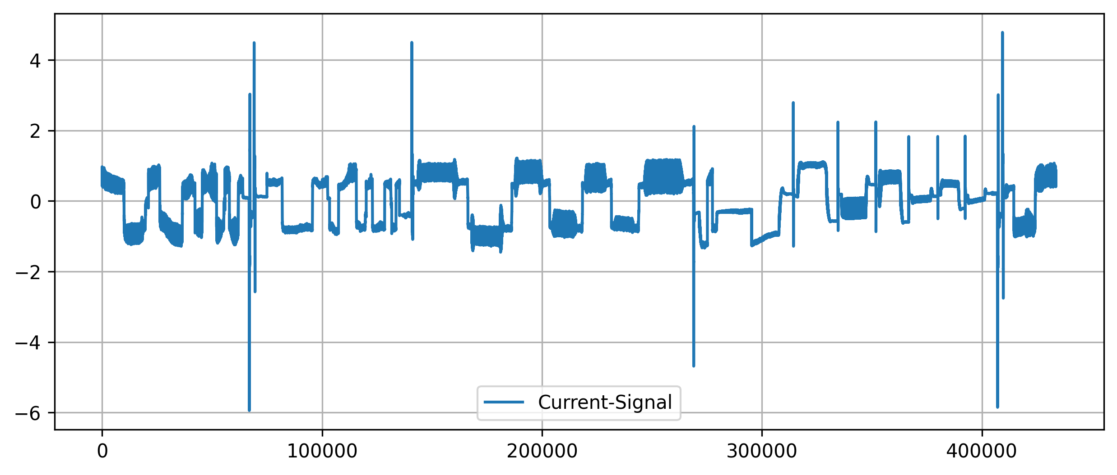
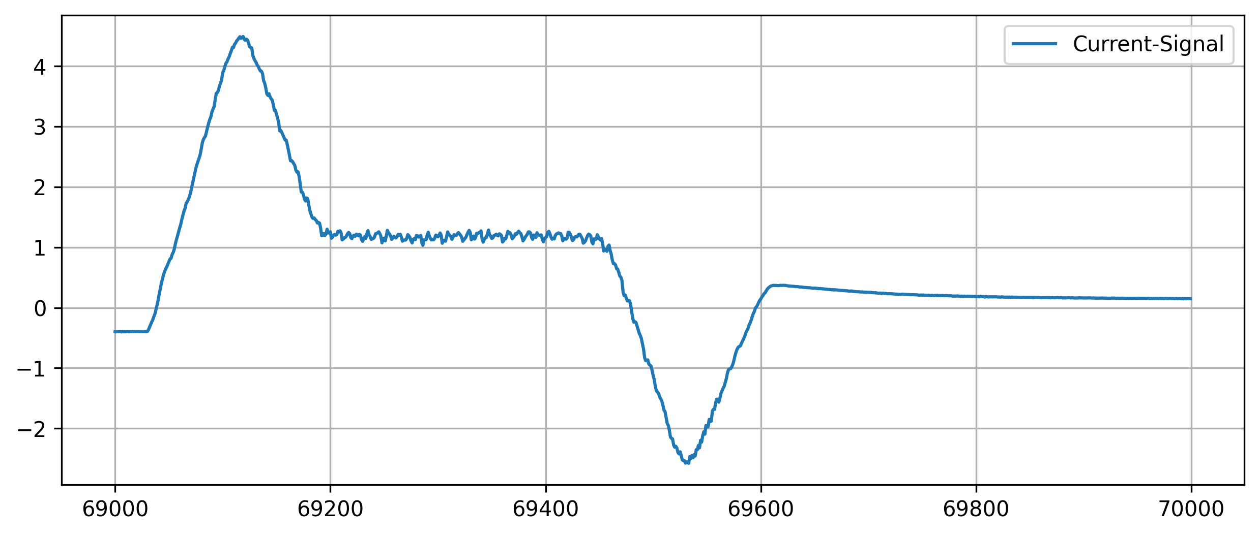
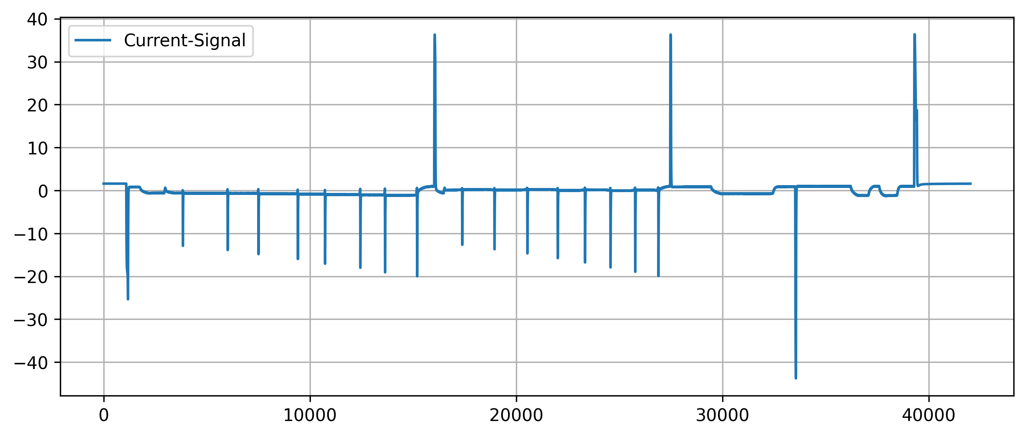
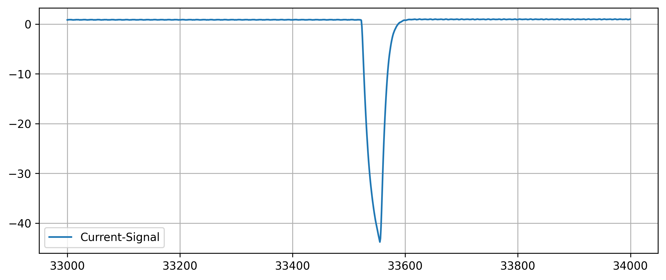
1. Introduction
2.
3.
4.
5.
Analysis of peak characteristics
Peak Detection in Time Series | N. Weidemann, N. Wijemanne
Notes:
Peaks can have different shapes and widths

Slide 8
1.
Introduction
2.
Experimental Setup
3.
Results
4.
5.
Evaluation
Conclusion
Peak Detection in Time Series | N. Weidemann, N. Wijemanne

Slide 9
1.
2. Experimental Setup
3.
4.
5.
Univariate (and linear) methods
Multivariate (and non-linear) methods
Threshold-Based
Moving-Average
Wavelet Transform
DBSCAN
K-Means
Autoencoder
Isolation Forest
Broad variety of techniques from simple to complex and data-driven
Peak Detection in Time Series | N. Weidemann, N. Wijemanne
Notes:
Linear methods assume a linear relationship or operate via linear operations
Nonlinear methods model complex, nonlinear relationships
Univariate methods analyze one time series at a time
Multivariate methods can consider multiple dimensions/features simultaneously

Slide 10
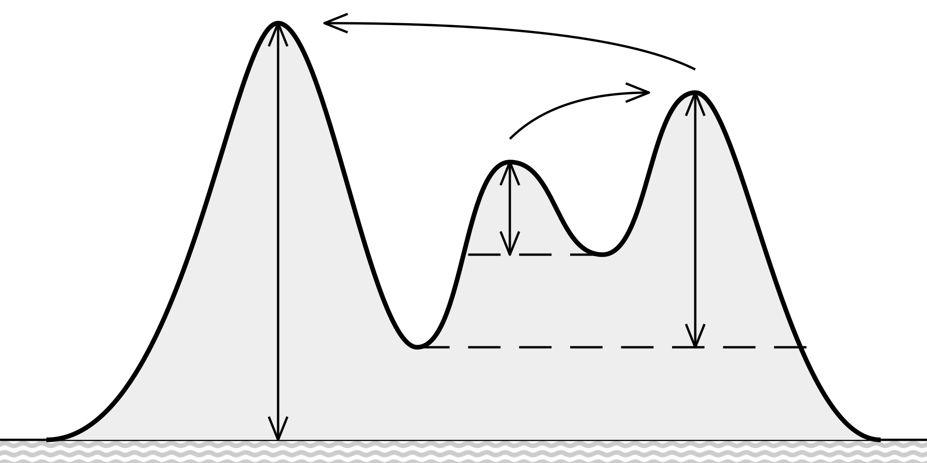
1.
2. Experimental Setup
3.
4.
5.
Threshold-Based Approach
A point is identified as a peak if:
It is a local maximum
Its value exceeds a threshold
Its prominence exceeds a threshold
Input-Feature-Variants
Torque with removed DC-offset
Absolute gradient of the command-speed
Peak Detection in Time Series | N. Weidemann
Notes:
Parameters: value-threshold, prominence-threshold
Prominence measures how much a peak stands out from surrounding valleys
A peak's prominence is the vertical distance between the peak and the lowest contour line that surrounds it and contains no higher peak
Higher prominence = more significant or isolated peak
Local maximum check: implicitly a window-size of 3

Slide 11
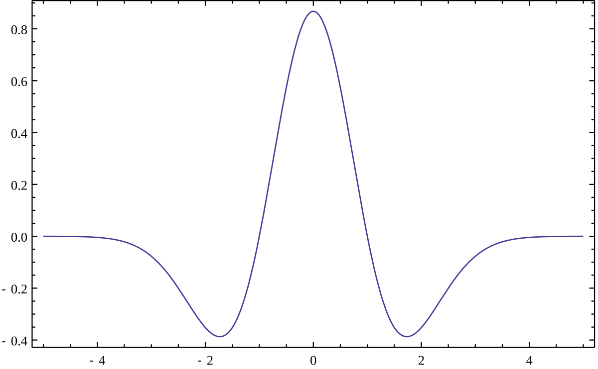
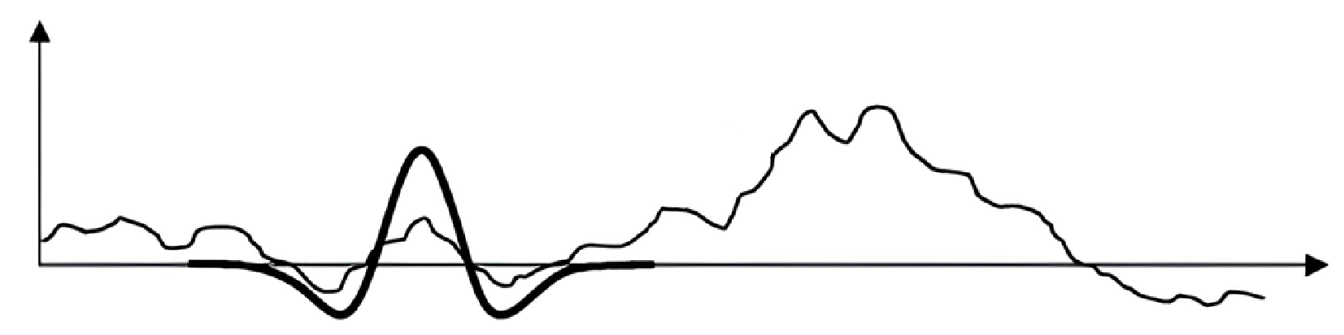
1.
2. Experimental Setup
3.
4.
5.
Wavelet-Transform
Using the Ricker wavelet as a basis function
Scale the wavelet and apply convolution on the target signal
High response indicates strong similarity
Peak Detection in Time Series | N. Weidemann
Notes:
Parameters: width/scale of the wavelet, (response-percentile)
Scipy considers every response in the lower 10th-percentile as noise
Convolution: shift -> normalize (local) -> dot-product
Matrix: coefficients across different scales (frequencies) and positions (time)
Peaks appear as strong, aligned coefficients across multiple scales
Scipy uses a signal-to-noise ratio logic implicitly to judge peak strength

Slide 12
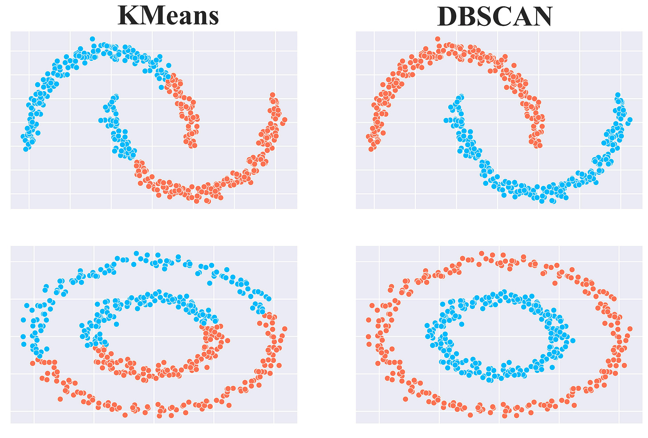
1.
2. Experimental Setup
3.
4.
5.
Clustering with K-Means
Training an autoencoder
Using Encoder to transform inputs into latent-space
Randomly initialize K centroids
Assign each point to the nearest centroid
Recompute the centroids by calculating the mean of all points assigned to it
Peak Detection in Time Series | N. Weidemann
Notes:
Parameters: number of clusters “k”
Autoencoder tries to reproduce the input
Repeat until changes in cluster assignments are minimal
Partitioning the data into k groups based on minimizing the distance between points and their assigned cluster centroids

Slide 13
1.
2. Experimental Setup
3.
4.
5.
Clustering with DBSCAN (Density-Based Spatial Clustering of Applications with Noise)
Training an autoencoder
Using Encoder to transform inputs into latent-space
Grouping together points that are closely packed
Marking those as outliers that lie alone in low-density regions
Peak Detection in Time Series | N. Weidemann
Notes:
Parameters: epsilon controls the radius of neighborhood (distance threshold)

Slide 14
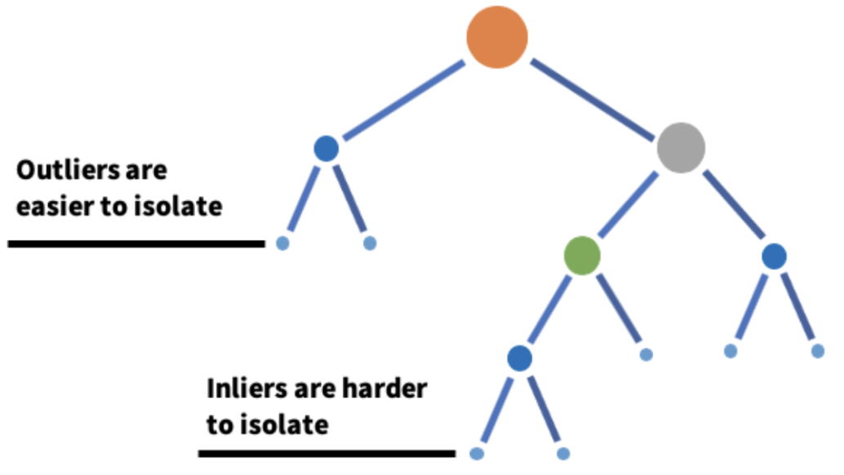
1.
2. Experimental Setup
3.
4.
5.
Isolation Tree
Robust for detecting outliers and noise within the data, both positive and negative
Does not assume the distribution of the data and useful for high dimensional datasets
However, since it was not built for timeseries data, feature engineering was done to provide more temporal context
Peak Detection in Time Series | N. Weidemann, N. Wijemanne
Notes:
Key parameter: contamination, number of trees
Uses Extremely Randomized Tree Regressors to separate anomalies from the rest of the data
Calculates an anomaly score for each data point and checks with a threshold. score depends on avg path length of an isolated point and average depth of all data points. closer to 1, strong anomaly
https://www.youtube.com/watch?v=kN--TRv1UDY

Slide 15
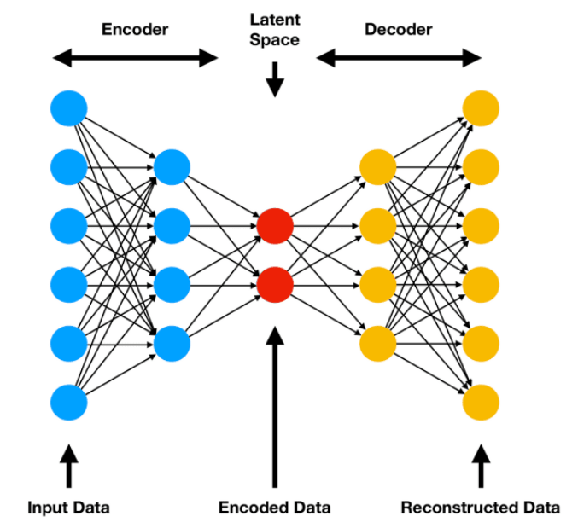
1.
2. Experimental Setup
3.
4.
5.
Encoder-Decoder
Detects anomalies for multivariate timeseries data by learning non-linear patterns
LSTMs – designed for sequences
Peaks – deviations with high reconstruction error
However, high computational cost, requires a lot of hyperparameter tuning, and hard to interpret.
Peak Detection in Time Series | N. Weidemann, N. Wijemanne
Notes:
An autoencoder is a neural network model that seeks to learn a compressed representation of an input, known as the latent space. And the decoder tries to recreate the features based on the compressed representation. The goal is to minimize the difference between the original and reconstructed data.
Long Short-Term Memory, or LSTM, network are specifically designed to support sequences of input data.
If the reconstructed output is different from the original input, it can show an anomaly or outlier which makes autoencoders useful for fraud detection and system monitoring.
LSTM training is slower than CNNs
Hyperparameters: Number of layers/units, Sequence length, Learning rate, Dropout Batch size
Other parameters: reconstruction error threshold → IQR/percentile etc.

Slide 16
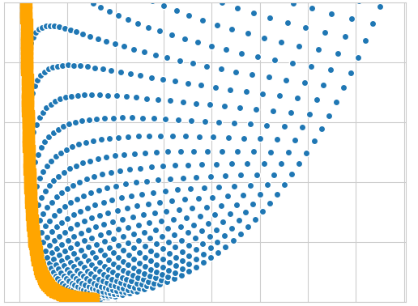
1.
2. Experimental Setup
3.
4.
5.
Determining the parameters
Since no ground truth is available, the quality of the parameters is estimated purely from statistical metrics:
Total number of peaks
Mean peak height
Mean peak prominence
Count of sequences without peaks
Using Pareto-Front-Analysis to select the best solution
Explain pareto front analysis -> visualization of example
Reason for use: majority of people us this in papers
Peak Detection in Time Series | N. Weidemann, N. Wijemanne
Notes:
Multi-Objective Optimization with Pareto-Front
Count of sequences without peaks -> indicating missed detections
Total number of peaks -> indicating sensitivity
Average peak height -> indicating proportion of true-positives
Average peak prominence -> indicating significance of the peaks

Slide 17
1.
Introduction
2.
Experimental Setup
3.
Results
4.
5.
Evaluation
Conclusion
Peak Detection in Time Series | N. Weidemann, N. Wijemanne

Slide 18
1.
2.
3. Results
4.
5.
Method | Features | Parameters |  | Peak-Count | Mean Height | Mean Prominence | Peakless Sequences
Threshold-Based | Torque | Threshold = 5 | Min-Prominence = 1.1 | 2977 | 5.03 | 0.89 | 0
Threshold-Based | Cmd.-Speed | Threshold = 0.7 | Min-Prominence = 1.1 | 660 | 6.74 | 0.13 | 0
Moving-Average
Wavelet-Transform | Torque | Min-Width = 100 | Max-Width = 150 | 4964 | 0.88 | 0.05 | 0
DBSCAN | Torque | Epsilon = 3.5 |  | 91936 | 3.2 | 0.16 | 0
K-Means | Cmd.-Speed | K-Clusters = 2 |  | 365670 | 1.2 | 0.09 | 0
Autoencoder | Torque
Isolation Forest
Summarize parameters in one table
Peak Detection in Time Series | N. Weidemann, N. Wijemanne
Notes:
Optimal compromise between all metrics
Best tradeoff between amplitude and prominence with a more realistic peak count

Slide 19
Results – Isolation Tree
Selected parameters
Features: Torque, Moving Average of Torque as input
Parameters:
Contamination: 0.01
Number of estimators: 100
Higher median F1 score (against pseudo labels ) and more realistic peak count
However, better results for certain sequences → Not very generalizable
Peak Detection in Time Series | N. Weidemann, N. Wijemanne

Slide 20
Results – Autoencoder
Selected parameters
Features: Torque as input
Parameters:
Contamination: 0.01
Latent dims: 8
Epochs: 50
Batch size: 64
Peaks were not detected at all in some sequences
However, good results for certain sequences → Not very generalizable
Peak Detection in Time Series | N. Weidemann, N. Wijemanne

Slide 21
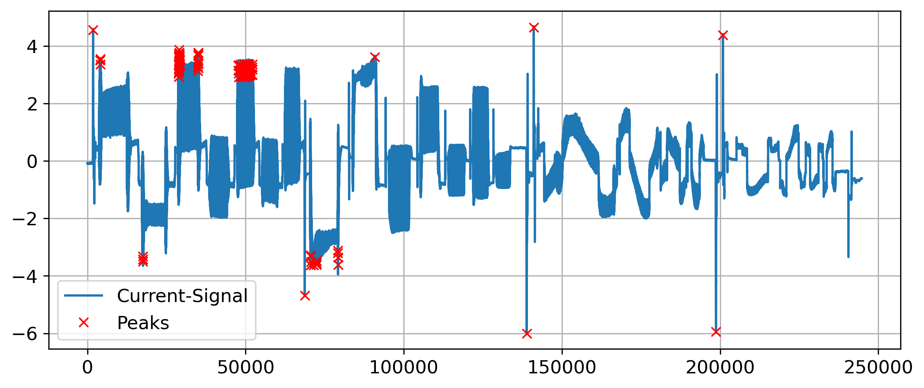
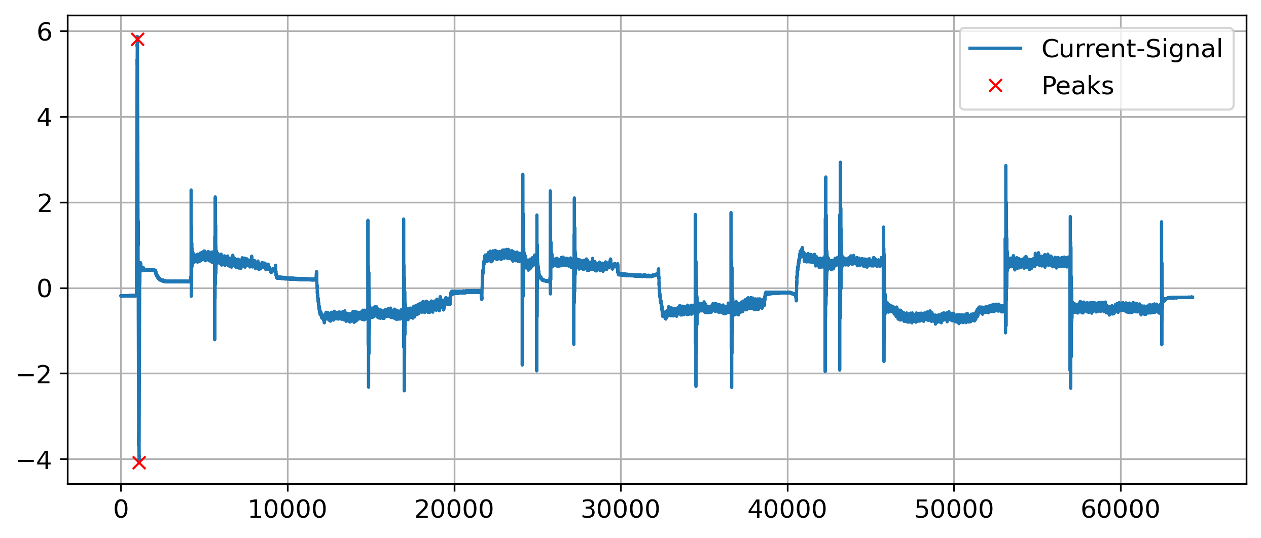
1.
2.
3. Results
4.
5.
Threshold-Based Detection (Torque)
Good precision on easy examples
Few true peaks were undetected
Peak Detection in Time Series | N. Weidemann, N. Wijemanne
Notes:
Good precision on easy examples with large outliers but fails on others with many false-positives -> bad generalization
Predicting one precise position and not an area
Can detect positive and negative peaks
Example-pictures: Seq2 ax1 Seq5 ax1

Slide 22


1.
2.
3. Results
4.
5.
Threshold-Based Detection (Cmd.-Speed)
Very high precision
Most of the true peaks were detected
Peak Detection in Time Series | N. Weidemann, N. Wijemanne
Notes:
No false-positives
Most of the true peaks were detected but not all (especially peaks with a smaller amplitude)
Predicting one precise position and not an area
Can detect positive and negative peaks
Example-pictures: Seq2 ax1 Seq5 ax1

Slide 23
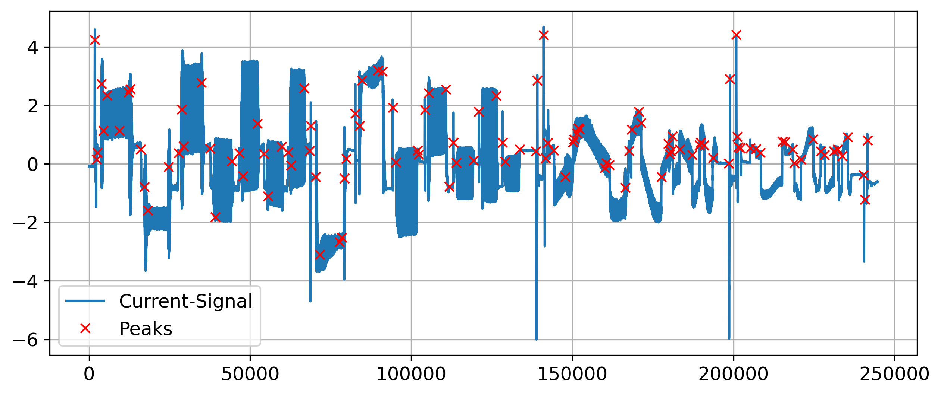
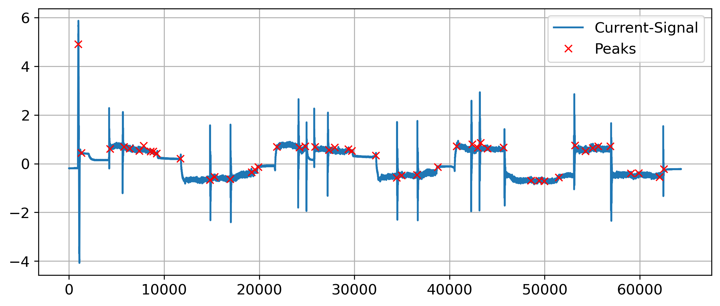
1.
2.
3. Results
4.
5.
Wavelet Transform
Very bad precision
Most of the true peaks were detected but not all
Possible reasons of failure:
Peaks have different shapes and widths
Shape is indistinguishable from noise
Peak Detection in Time Series | N. Weidemann, N. Wijemanne
Notes:
Many false-positives
Predicting one precise position and not an area
Can detect only positive peaks (with one single wavelet)
Example-pictures: Seq2 ax1 Seq5 ax1

Slide 24
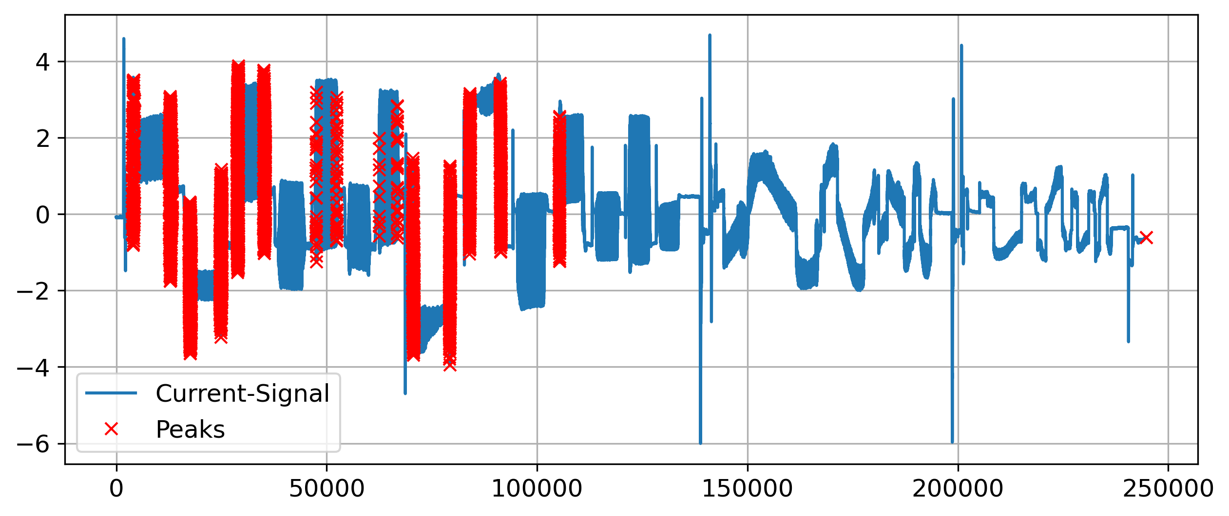
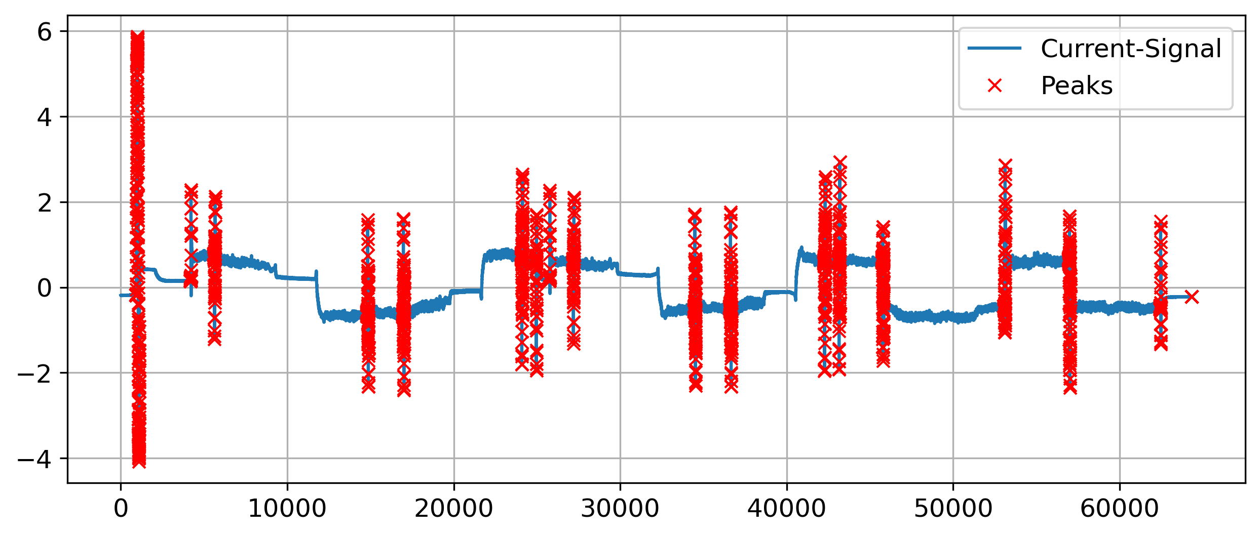
1.
2.
3. Results
4.
5.
Clustering with DBSCAN
High precision
Some peaks were not detected
Recognizable tendency of detecting peaks
Peak Detection in Time Series | N. Weidemann, N. Wijemanne
Notes:
Almost no false-positives
Marking the whole peak area instead of just one precise position
Can detect positive and negative peaks
Example-pictures: Seq2 ax1 Seq5 ax1

Slide 25
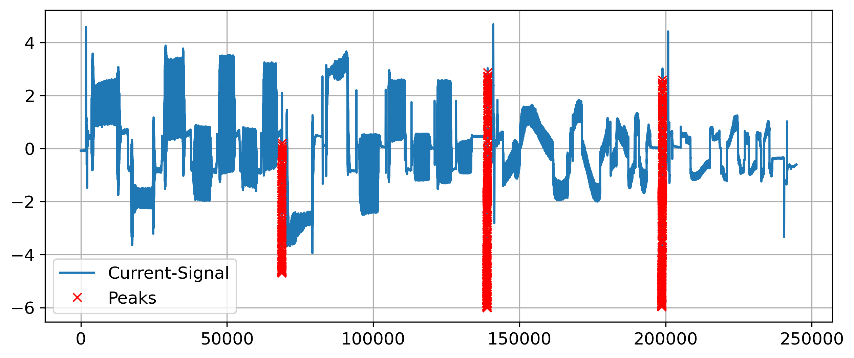
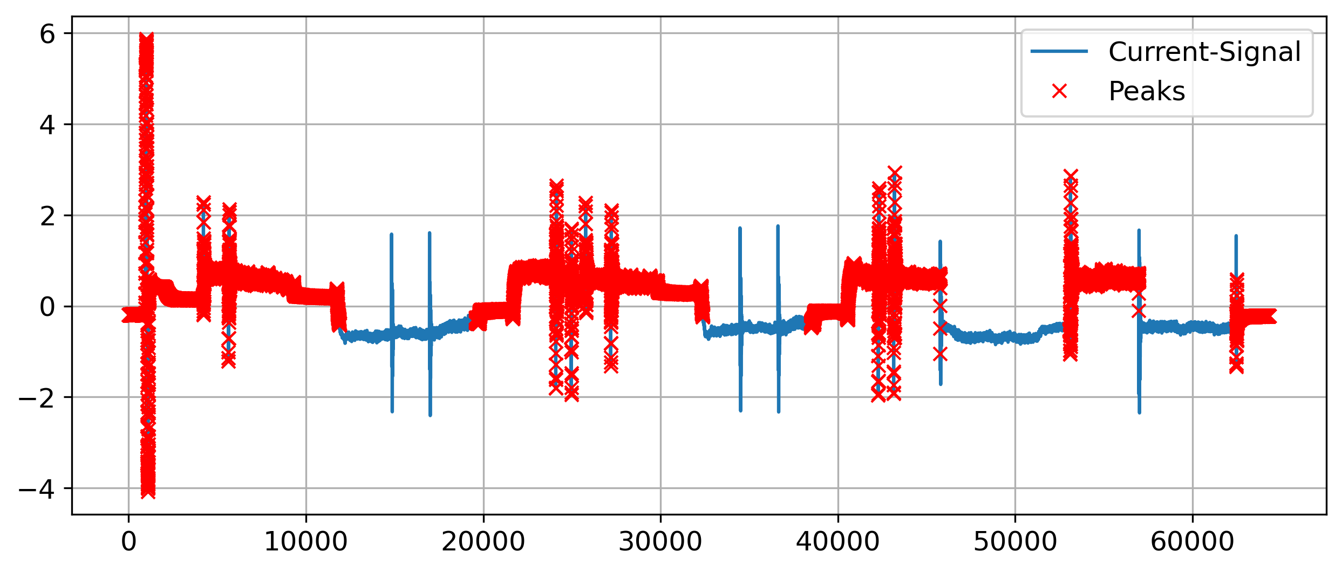
1.
2.
3. Results
4.
5.
Clustering with K-Means
False-positives issues on some sequences
Many peaks were undetected
Unreliable predictions
Peak Detection in Time Series | N. Weidemann, N. Wijemanne
Notes:
Can detect positive and negative peaks
Marking the whole peak area instead of just one precise position
Example-pictures: Seq2 ax1 Seq5 ax1

Slide 26
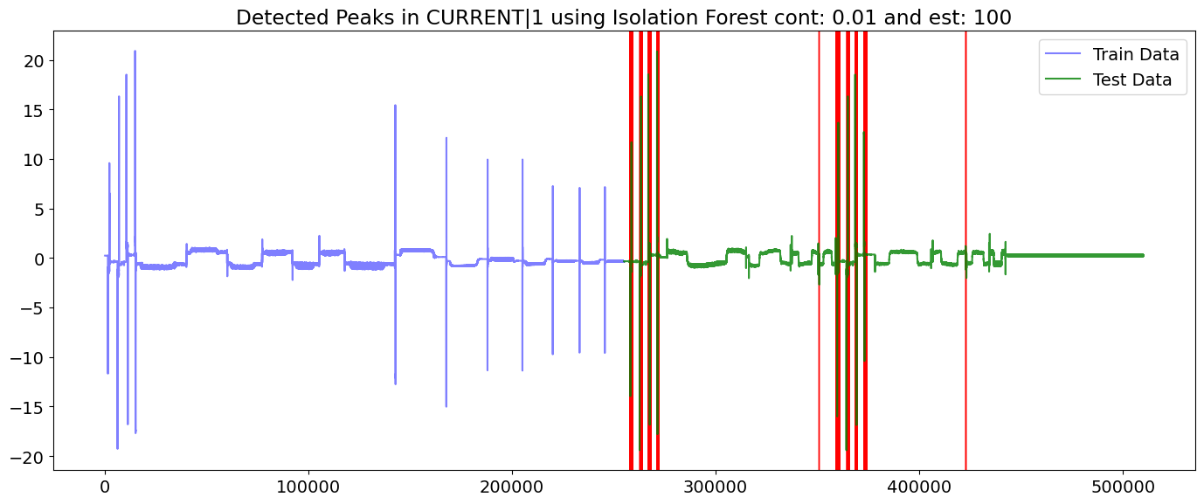
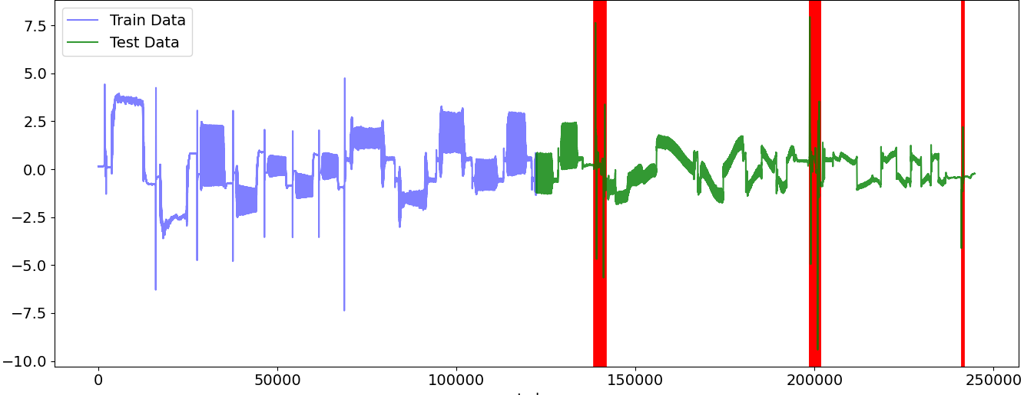
1.
2.
3. Results
4.
5.
Isolation Tree
Not many false-positives issued on the sequences
Many peaks were not detected
Characteristic of marking the whole peak area instead of just one precise position
Can detect positive and negative peaks
Peak Detection in Time Series | N. Weidemann, N. Wijemanne

Slide 27
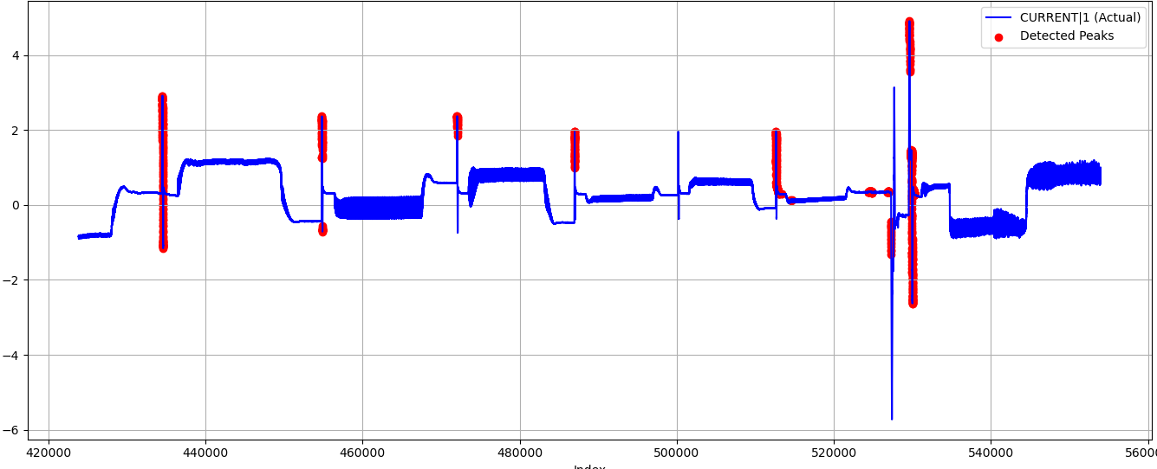
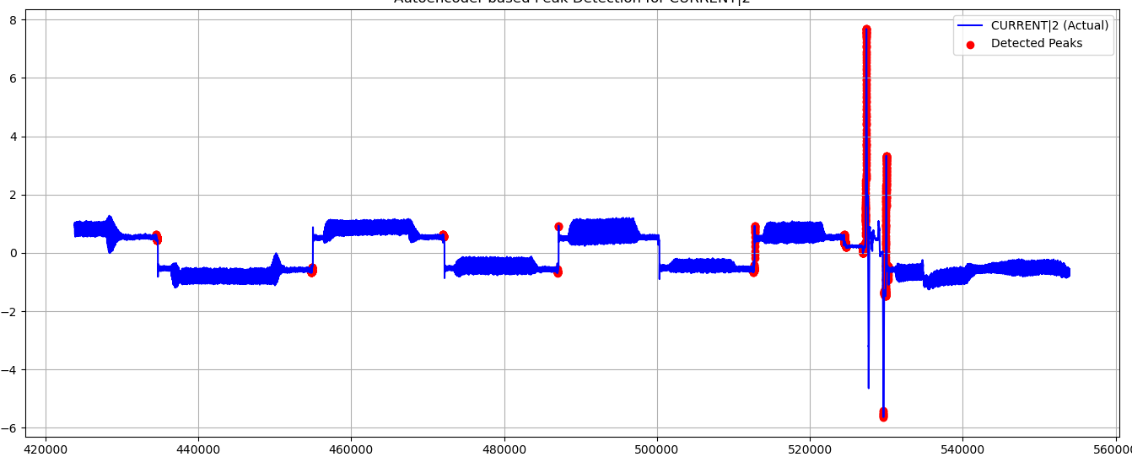
1.
2.
3. Results
4.
5.
Autoencoder
Not many false-positives issued on the sequences
Many peaks were not detected
Can detect positive and negative peaks
Detects smaller deviations but sometimes unable to identify larger deviations → not good
Peak Detection in Time Series | N. Weidemann, N. Wijemanne

Slide 28
1.
Introduction
2.
Experimental Setup
3.
Results
4.
5.
Evaluation
Conclusion
Peak Detection in Time Series | N. Weidemann, N. Wijemanne

Slide 29
1.
2.
3.
4. Evaluation
5.
Key Criteria
Applicability
Computational costs / speed / complexity
Precision and Recall
Robustness and Generalization
Draft
Peak Detection in Time Series | N. Weidemann, N. Wijemanne

Slide 30
1.
2.
3.
4. Evaluation
5.
Best solution: Threshold-Based Detection
Feature-processing forces the user to analyze and understand the data, which can already give some insights into the reason for the anomalies
Fast computation with low resource allocation
Few parameters to optimize
High precision and recall if the processed input feature is suitable
Struggles to generalize on raw peak data
Draft
Peak Detection in Time Series | N. Weidemann, N. Wijemanne

Slide 31
1.
Introduction
2.
Experimental Setup
3.
Results
4.
5.
Evaluation
Conclusion
Peak Detection in Time Series | N. Weidemann, N. Wijemanne

Slide 32
1.
2.
3.
4.
5. Conclusion
Recommended workflow
Start with a simple method
Develop suitable input features
Optimize the parameters
Continue with a more complex approach
Draft
Peak Detection in Time Series | N. Weidemann, N. Wijemanne

Slide 33
1.
2.
3.
4.
5. Conclusion
Findings
Anomalies are likely caused by sudden changes in the commanded speed (speed setpoint from the trajectory planner to the motor controller)
Sharp edges in the speed setpoint seem to cause the peaks in the current
There seems to be a bug within the planning unit
Spindle signal looks like a discrete signal with hard edges (instead of smooth, continuous transitions
Draft
Peak Detection in Time Series | N. Weidemann, N. Wijemanne

Slide 34
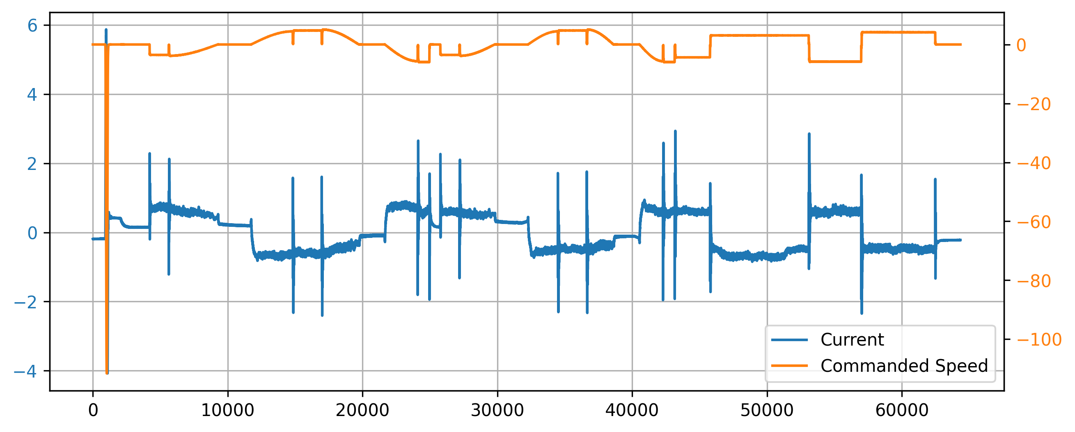
1.
2.
3.
4.
5. Conclusion
3 different types of anomalies
Large outlier
Signal flickers to zero
Jumping between quantized levels
1.
2.
3.
Peak Detection in Time Series | N. Weidemann, N. Wijemanne

Slide 35
1.
2.
3.
4.
5. Conclusion
Ideas for improvement
Rescale the signals by a material-specific factor to align dynamics in the current caused by normal workload within the same zone to improve generalization
Consider both the width of each peak and its proximity to neighboring peaks
Apply smoothing to the signal to filter noise and remove unsignificant peaks
Coalescence (cluster formation): peaks that are close to each other (within a window distance k) are combined so that only the highest peak remains
Peak Detection in Time Series | N. Weidemann, N. Wijemanne

Slide 36
Peak Detection in Time Series
Presentation of Final Results
Thank You For Your Attention!
Nestor Weidemann
Mail: nestor.weidemann@st.ovgu.de
Nathira Wijemanne
Mail: nathira.wijemanne@st.ovgu.de

Slide 37
References for Graphics
[1] https://www.fptindustrie.com/deu/
[2] https://www.mdpi.com/1996-1073/17/15/3659
[3] https://en.wikipedia.org/wiki/Ricker_wavelet
[4] https://link.springer.com/article/10.1007/s10950-019-09845-y https://www.researchgate.net/figure/Convolution-of-a-signal-with-a-wavelet-function-Part-of-this-figure-is-taken-from-1_fig1_51918746
[5] https://en.wikipedia.org/wiki/Topographic_prominence
[6] https://blog.dailydoseofds.com/p/the-limitations-of-dbscan-clustering
[7]
Peak Detection in Time Series | N. Weidemann, N. Wijemanne
Notes:
Clustering method -> Hyper parameter tuning
Autoencoder ->
Pseudo labels for evaluation for each approach
Considering efficiency and computational cost when evaluating

Slide 38
References for Graphics
[8] https://waterprogramming.wordpress.com/tag/pareto-dominance/
[9]
Peak Detection in Time Series | N. Weidemann, N. Wijemanne
Notes:
Clustering method -> Hyper parameter tuning
Autoencoder ->
Pseudo labels for evaluation for each approach
Considering efficiency and computational cost when evaluating

Slide 39
Backup
Peak Detection in Time Series | N. Weidemann, N. Wijemanne

Slide 40
Dataset
Number of Rows: ~1.6 Million
Time Series data across:
2 Machine Types (CMX1, DMC2)
2 Materials (AL, S)
2 Components (CP1, CP2)
-> 8 different measurements
Variables measured across 4 axes: X (1), Y (2), Z (3) and Spindle (6)
Target Variable: Current
Possible Input Variables: Load, Motor shaft positions (actual & desired), Control deviation, Torque, Feedforward velocity, Feedforward torque, Commanded Speed, and etc.
Peak Detection in Time Series | N. Weidemann, N. Wijemanne

Slide 41
Dataset
Relationships:
For all axes: Current ∝ Torque
For all Z: Current ∝ Load (>0.9 correlation)
Machine CMX1, Spindle: Current ∝ Load (>0.9 correlation)
Machine DMC2, Y & Z: Current ∝ Encoder Positions (>0.9 correlation)
Component 2, Y: Current ∝ Load (>0.9 correlation)
Component 1, Spindle: Current ∝ Load (~0.7 correlation)
Peak Detection in Time Series | N. Weidemann, N. Wijemanne

Slide 42
Intermediate Results
Sensitivity analysis was done for each technique to identify model that is best suited
Pseudo labels were used for metric calculation and evaluation
Metrics used:
F1 Score (using Pseudo labels)
Count of sequences with no peaks
Total number of peaks
Average peak height
Average peak prominence
Peak Detection in Time Series | N. Weidemann, N. Wijemanne
Notes:
· The prominence of a peak measures how much the peak stands out due to its intrinsic height and its location relative to other peaks. It's not just how high the peak is, but how independent it is from nearby peaks.

Slide 43
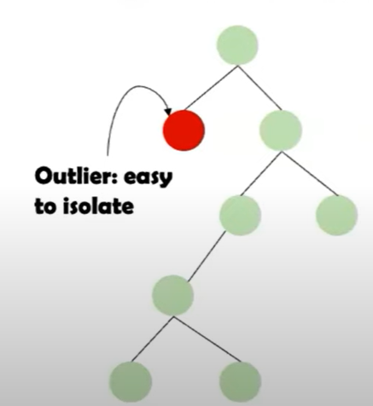
Explanation of the approaches
Isolation Forest
Uses Extremely Randomized Tree Regressors to separate anomalies from the rest of the data
Peak Detection in Time Series | N. Weidemann, N. Wijemanne
Notes:
Calculates an anomaly score for each data point and checks with a threshold. score is depends on avg path length of an isolated point and average depth of all data points. closer to 1, strong anomaly https://www.youtube.com/watch?v=kN--TRv1UDY

Slide 44
Explanation of the approaches
Autoencoder Model
Peak Detection in Time Series | N. Weidemann, N. Wijemanne
Notes:
Encoder: The encoder takes the input data (e.g., an image, a sound clip, or a text document) and compresses it into a lower-dimensional representation, known as the latent space or encoded representation.
Decoder: The decoder takes the compressed representation and tries to reconstruct the original input. The goal is to minimize the difference between the original and reconstructed data.
If the reconstructed output is different from the original input, it can show an anomaly or outlier which makes autoencoders useful for fraud detection and system monitoring.
https://towardsdatascience.com/auto-encoder-what-is-it-and-what-is-it-used-for-part-1-3e5c6f017726/

